Slide 1
Lesson-05

Slide 2
overview
Sequence to sequence
Encoder decoder architecture
Attention mechanism
Generate mechanism
机器翻译的原理
图像描述的原理
作业：中英文自动翻译模型的构建

Slide 3
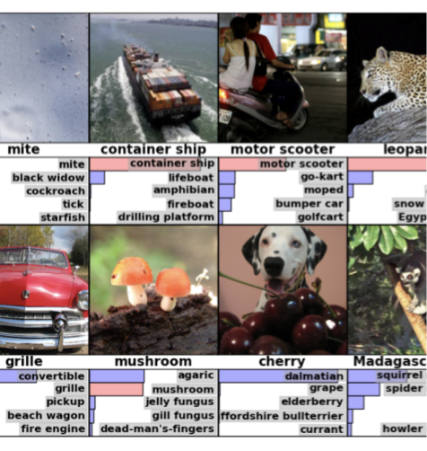
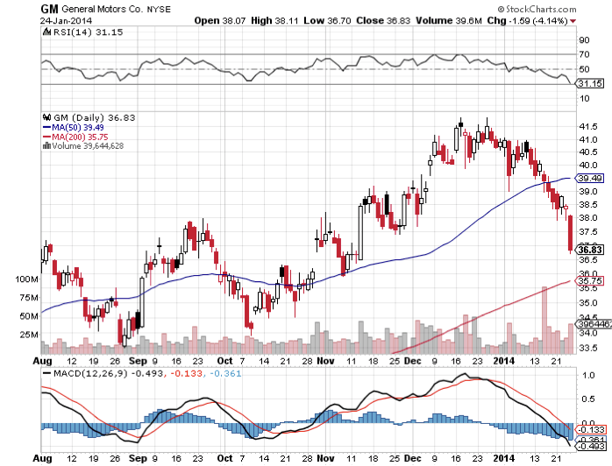
Why do we need seq2seq
1. Classification
f(vec) -> tag, categorical
2. Regression
f(vec) -> numerical value

Slide 4
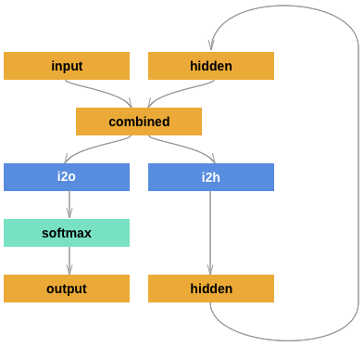
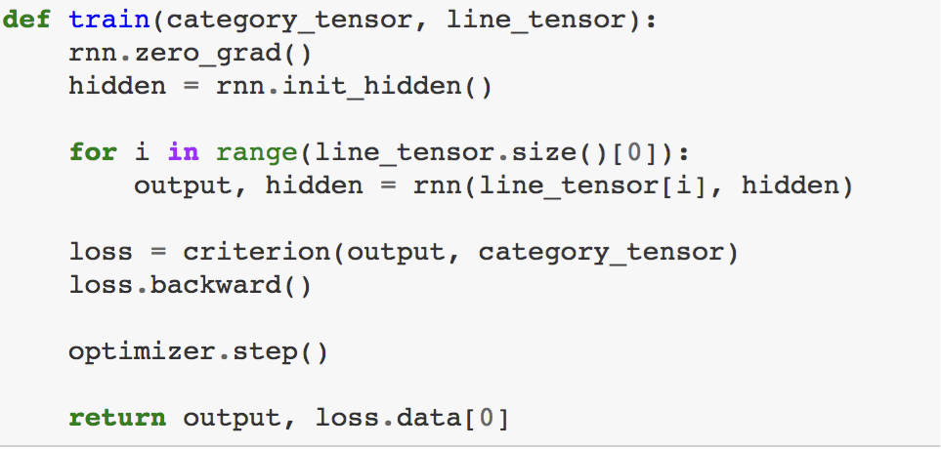
An example
Given a name, classify the right nationality
> Dovesky
(-0.87) Czech
(-0.88) Russian
(-2.44) Polish
> Jackson
(-0.74) Scottish
(-2.03) English
(-2.21) Polish
> Satoshi
(-0.77) Arabic
(-1.35) Japanese

Slide 5
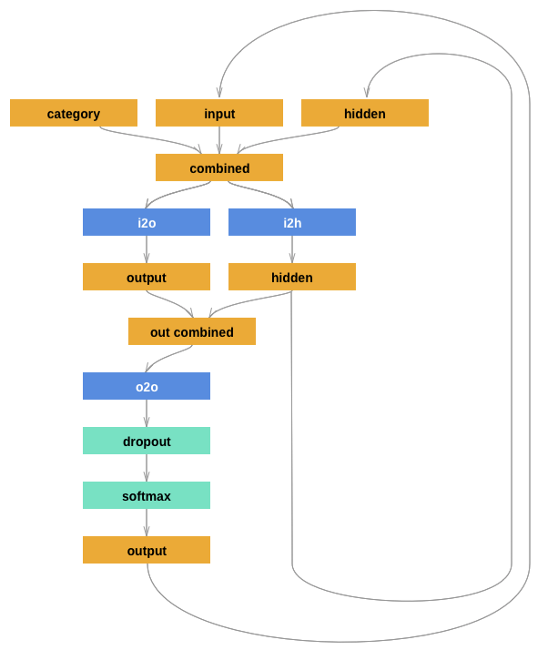
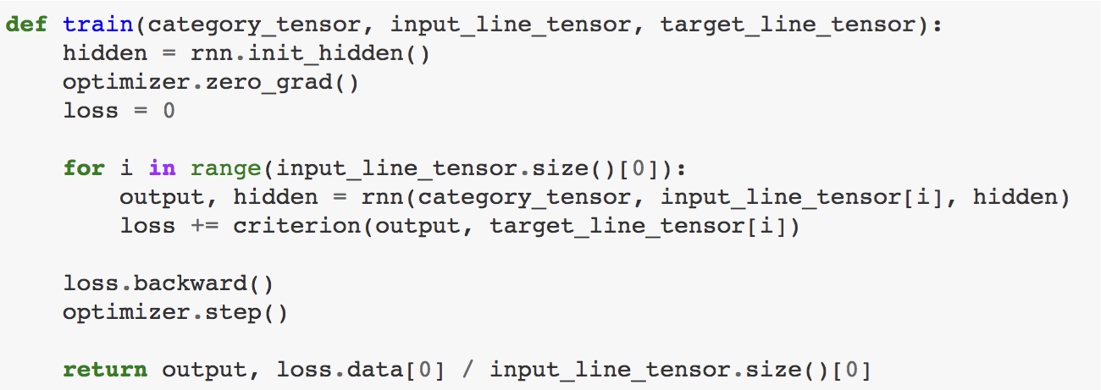
An example
Why not generate a new name based on nation?
> python generate.py Russian
Rovakov
Uantov
Shavakov
> python generate.py German
Gerren
Ereng
Rosher

Slide 6
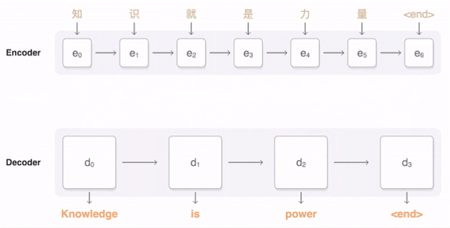
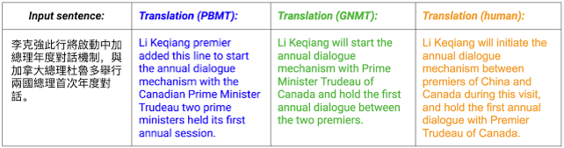
An example
variable length
-> nation
nation
-> variable length

Slide 7
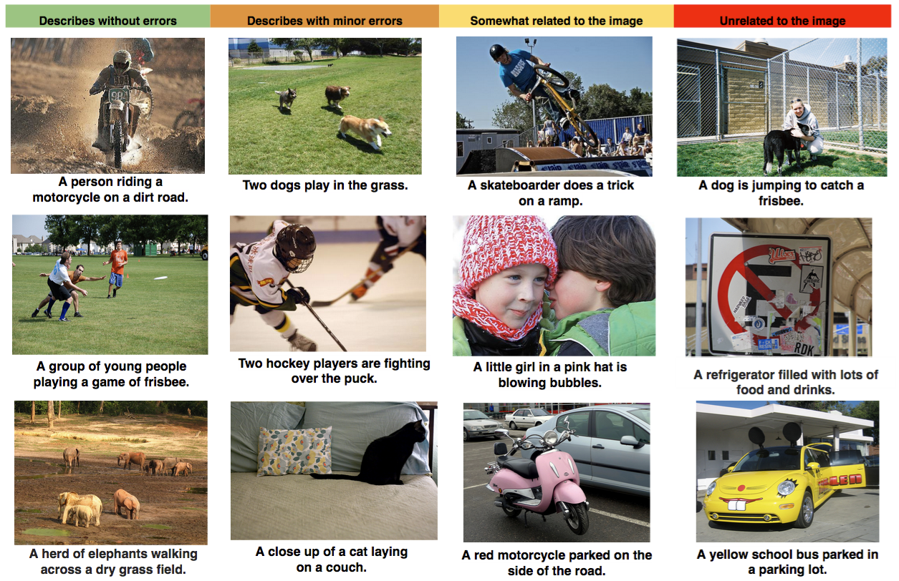
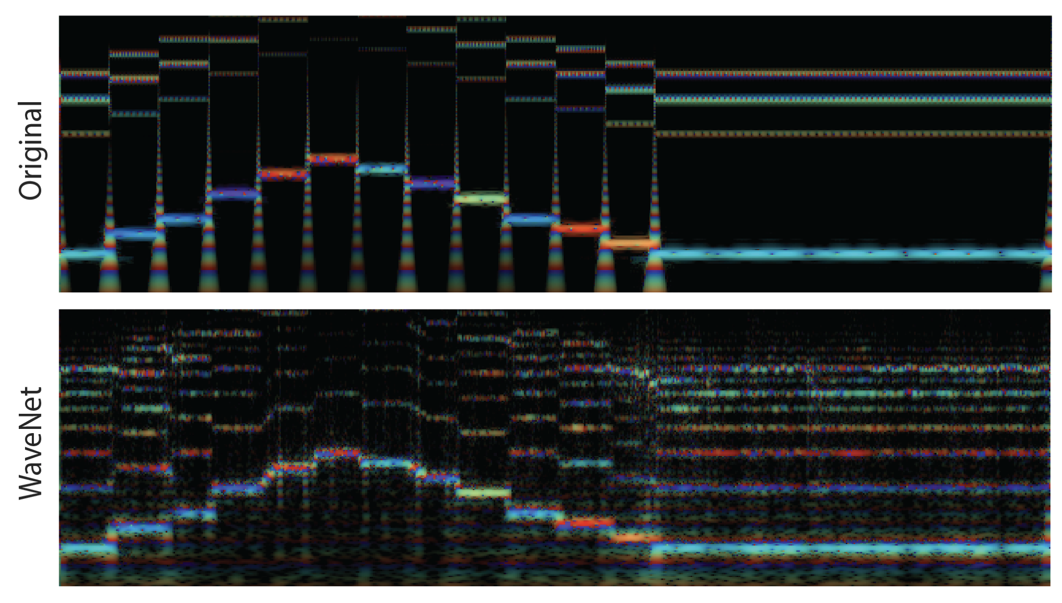
More...
1. Image Caption.
2. Music Generation.
3. Text Genearation.
4. Text Summarisation.
5. Machine Translation.
6. Dialogue System.
Input: <vec1, vec2, .. vec_n> Output: <vecN1, vecN2.. vecNi>

Slide 8
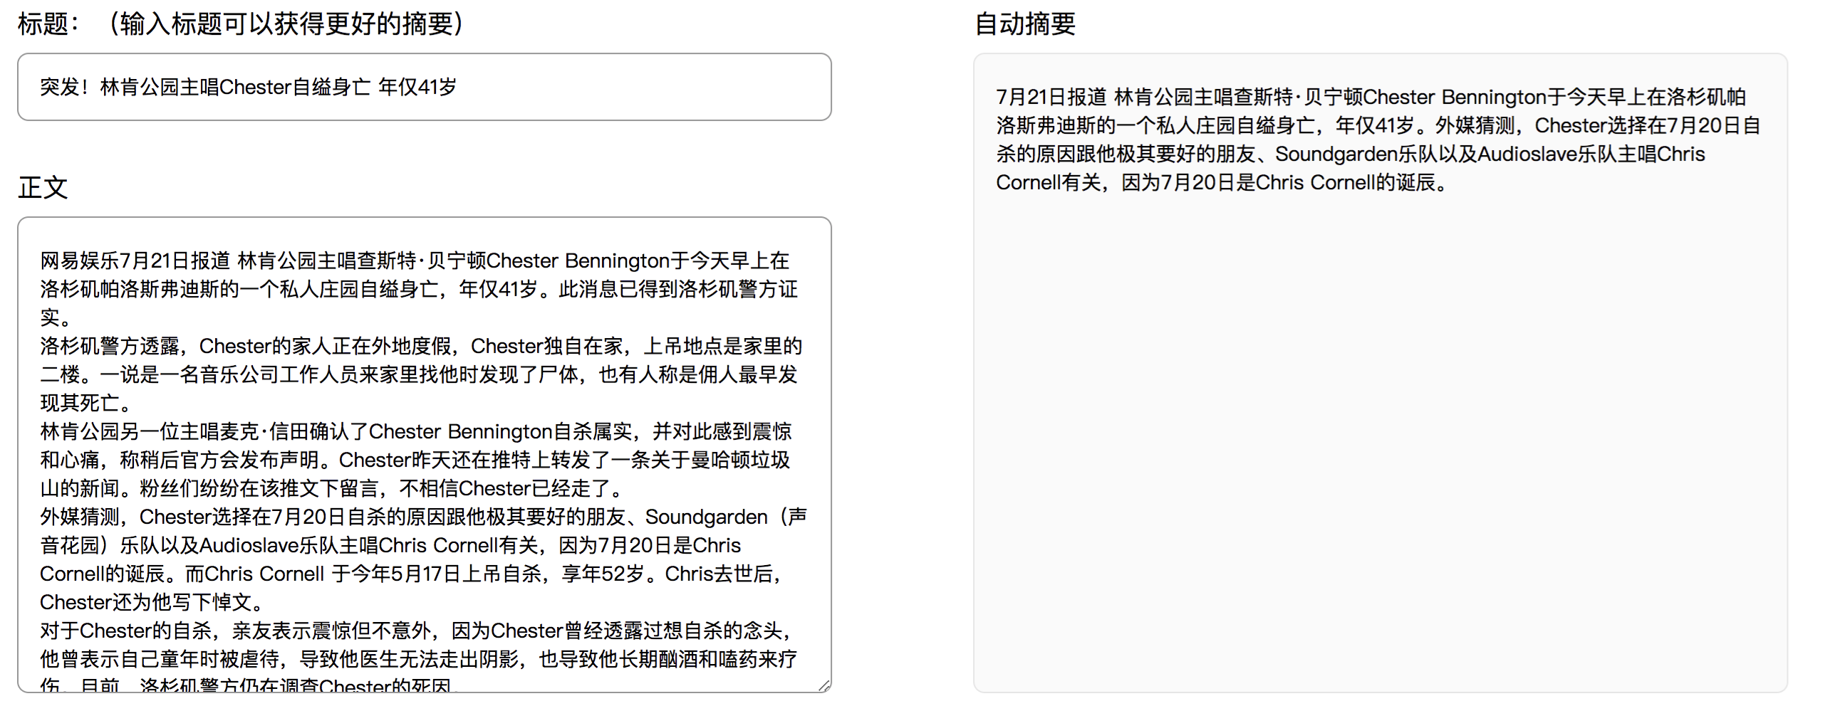

Slide 9
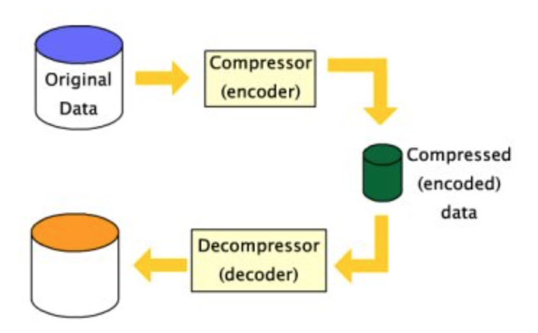
Encoder decoder architecture
The idea of encoder-decoder architecture comes from data compression.

Slide 10
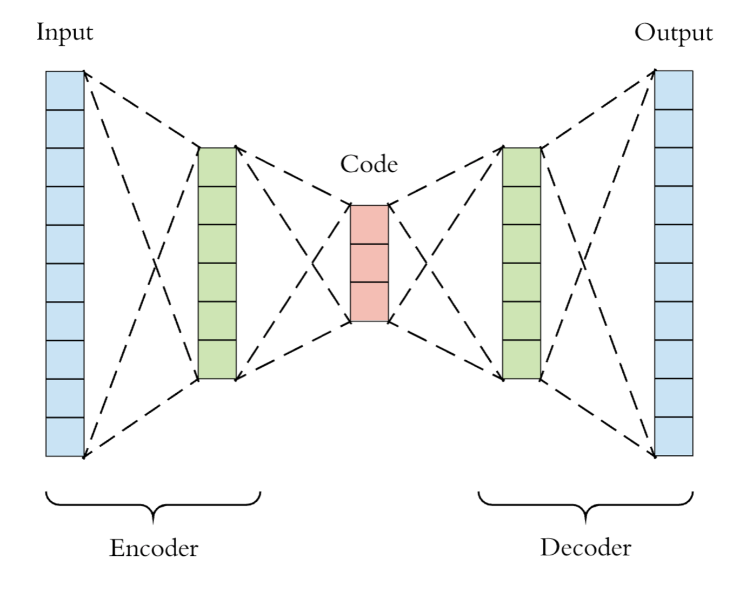
Neural encoder-decoder(autoencoder) architecture

Slide 11
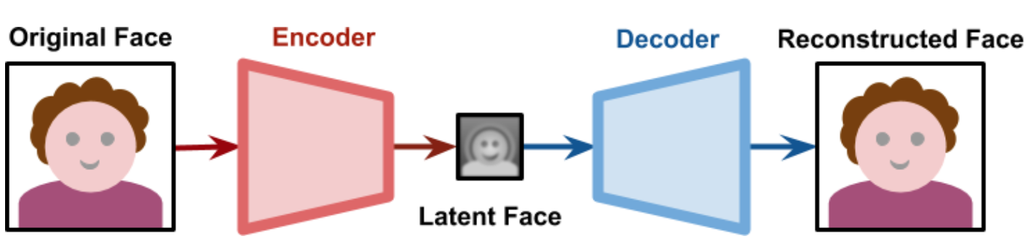
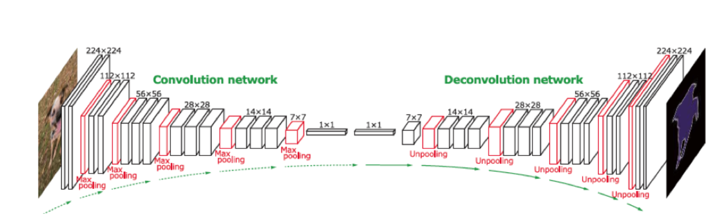
Some applications of cnn based autoencoder

Slide 12
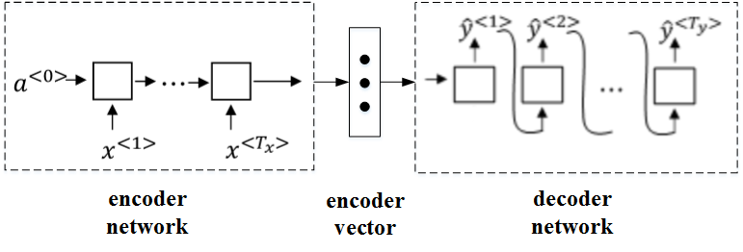
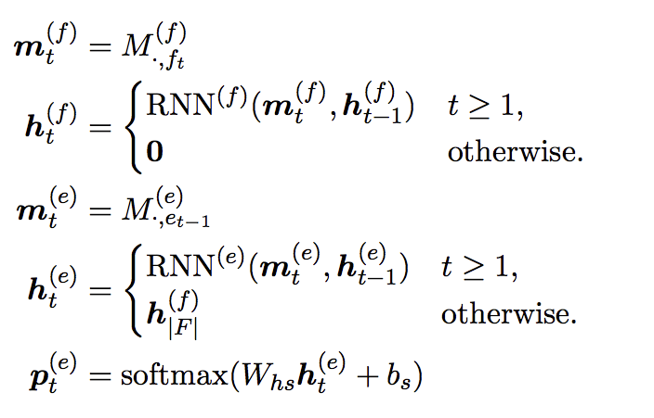
Sequence to sequence

Slide 13
Sequence to sequence( an example of MT with greedy search)
English: I like playing basketball.
Chinese: 我喜欢打篮球
我
喜欢
打
篮球
EOS
I
like
playing
basketball

Slide 14
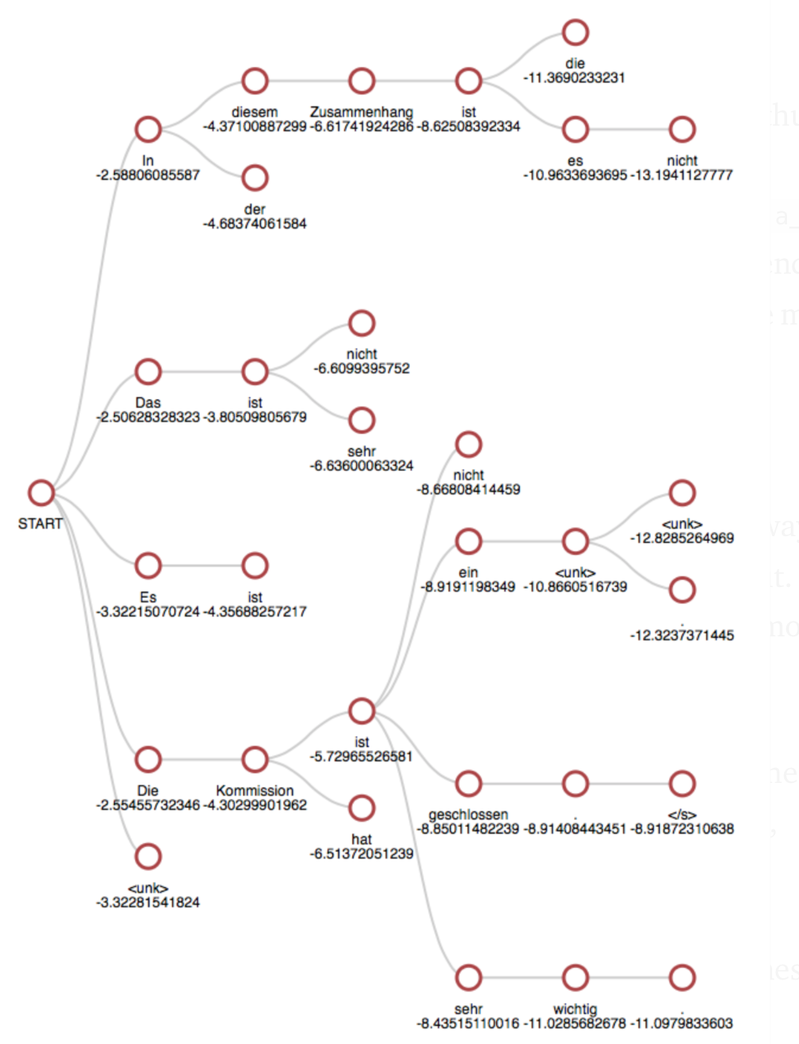
Beam search

Slide 15
Beam search(an example)
I
like
playing
basketball

Slide 16
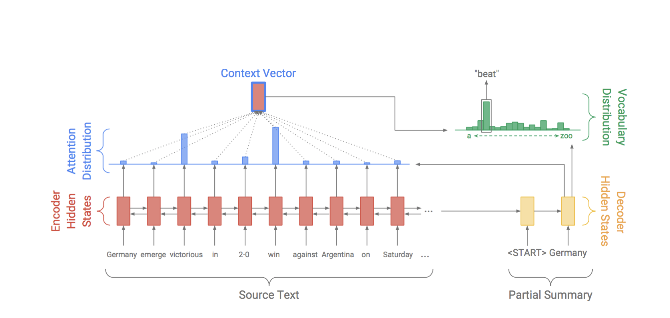
Seq2seq with attention
Look more information from input source, not only based on encoder result.
Dzmitry Bahdanau， et al, Neural Machine Translation by Jointly Learning to Align and Translate，

Slide 17
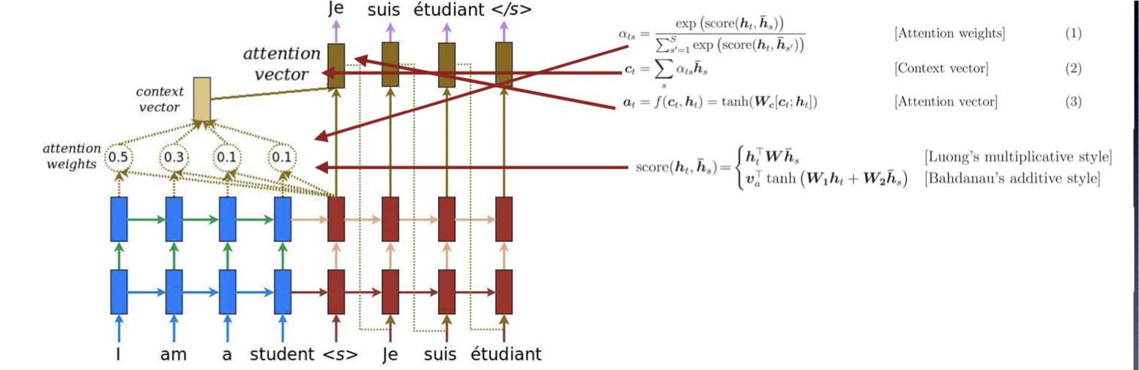
Attention mechanism

Slide 18
Image Caption

Slide 19
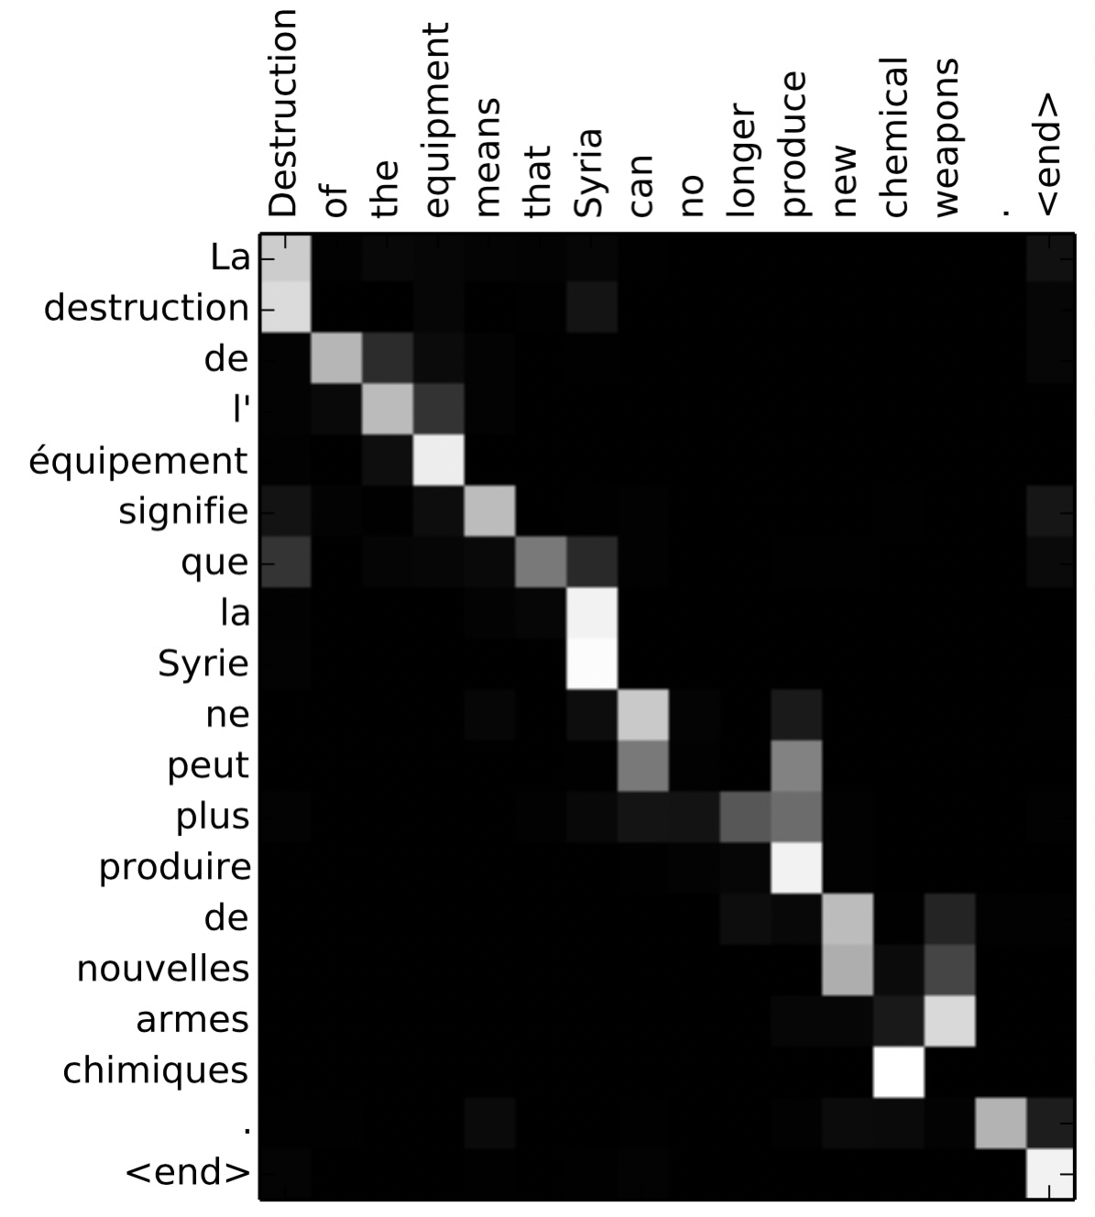
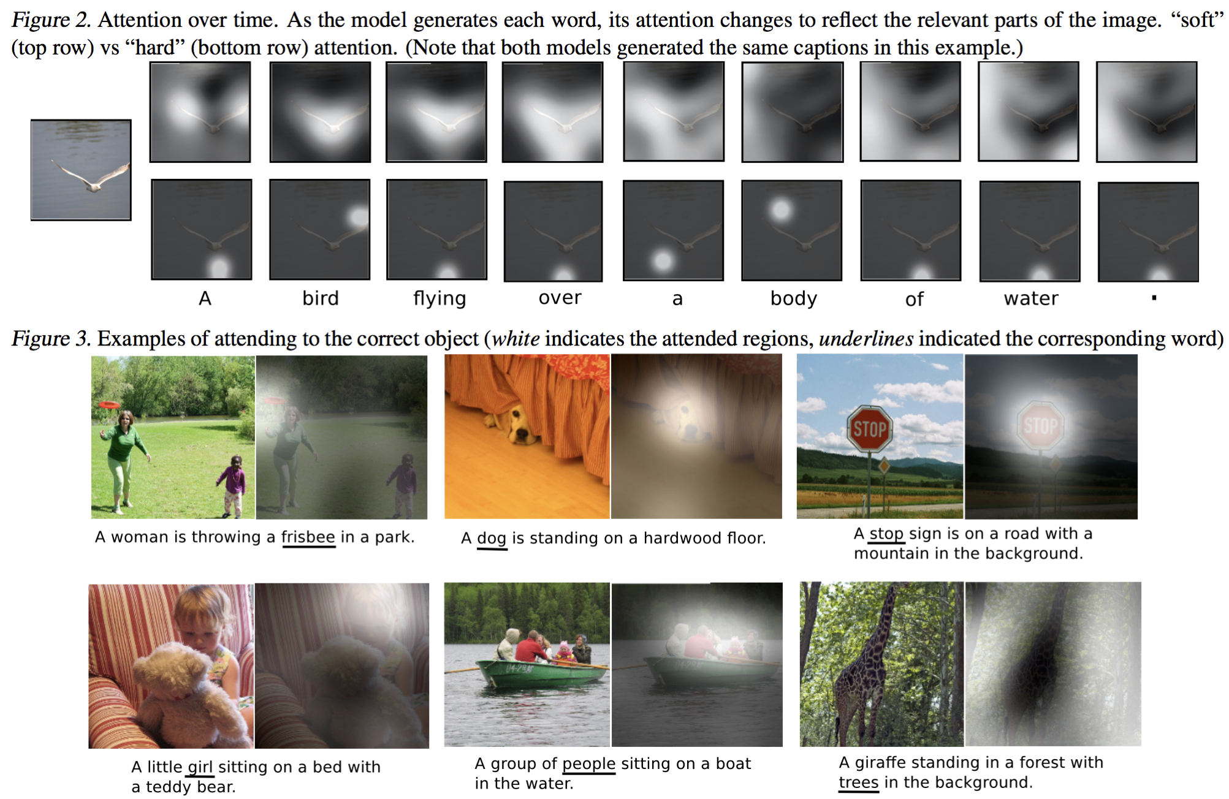
Image Caption

Slide 20
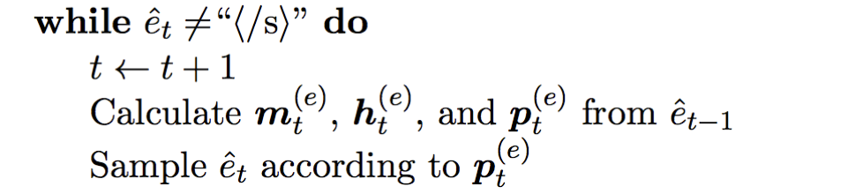
Generate output
1. Random Sampling: Randomly select an output E from the probability distribution P (E | F). This is usually denoted E^{ˆ} ⇠ P(E | F).
Get output_t, based on the probability distribution from context calculated by the time step output_{t-1}.
Random Output: Dialogue System Fast Computing.

Slide 21
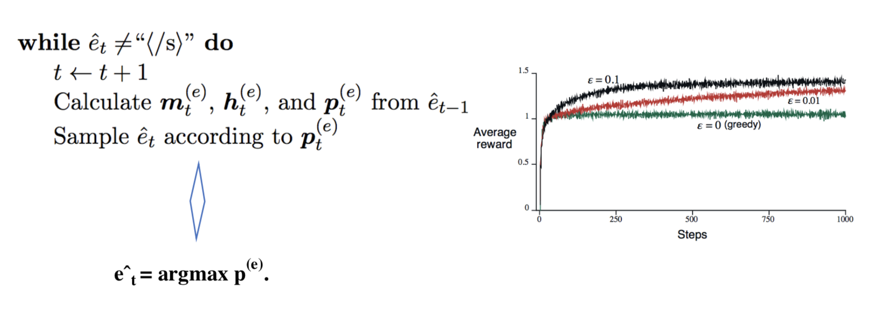
Generate output
2. Greedy 1-best Search: model output the best result, in which we simply calculate pt , at every time step, select the word that gives us the highest probability, and use it as the next word in our sequence.
! greedy search is not guaranteed to find the translation with the highest probability

Slide 22
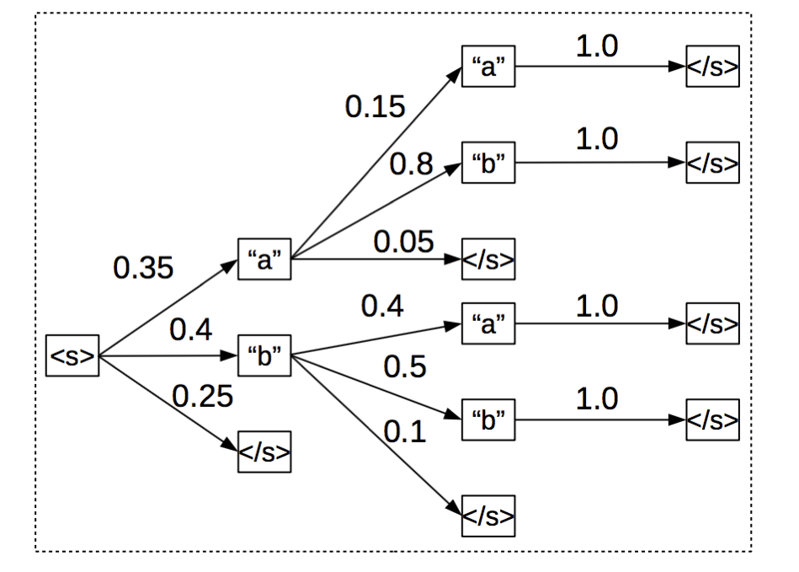
Generate output
3. Beam-Search: we consider b best hypotheses at each time step, where b is the “width” of the beam.

Slide 23
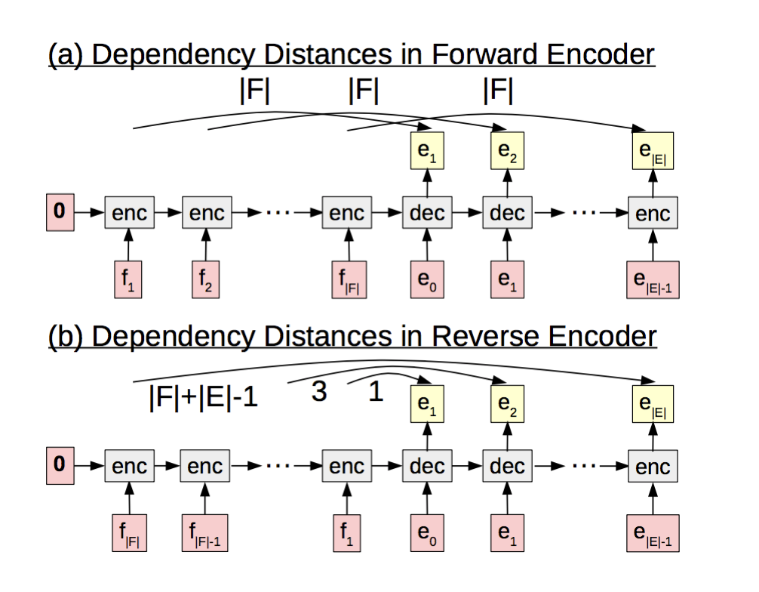
Other ways of encoding sequence
Reverse and Bidirectional

Slide 24
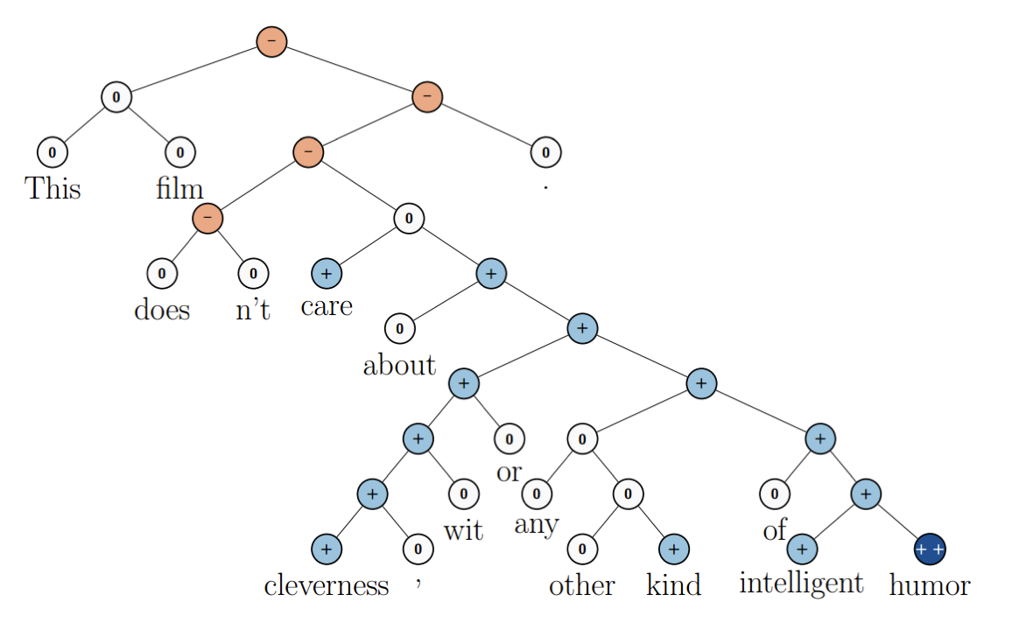
2. Tree-RNN
LSTMs or other RNNs are simpler format of Tree-RNN.
Need dynamic graph support.

Slide 25
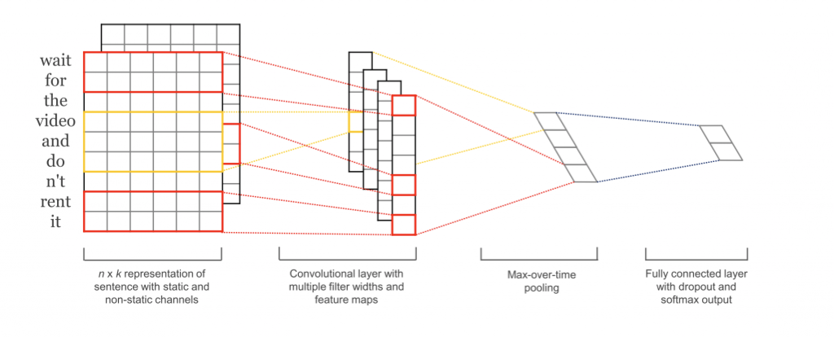
3. Convolutional Neural Networks. It’s much faster than using RNN to model Text.

Slide 26
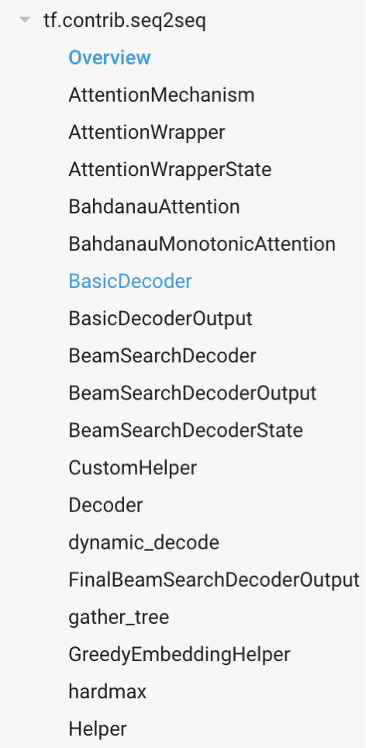
TensorFlow.Seq2Seq
TensorlFlow >= 1.2v If version is older than 1.2, could look more
information in https://github.com/google/seq2seq.
• 1. Build Training Batch.
——————————————————-
• 2. Embedding. • 3. Get Encoding. • 4.AddAttention.
——————————————————
• 5. Decode. • 6. Train. • 7. Genrate Outputs.
——————————————————
•8. Result Analysis.

Slide 27
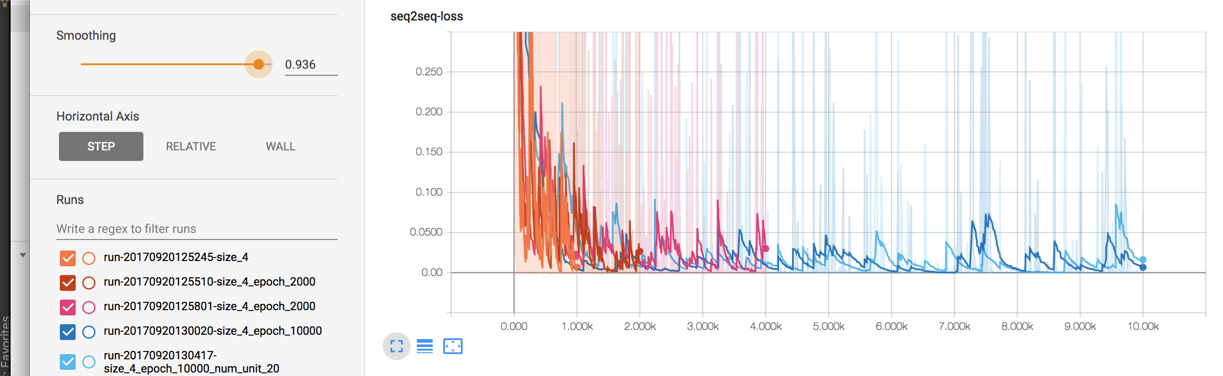
Resulting analysis

Slide 28
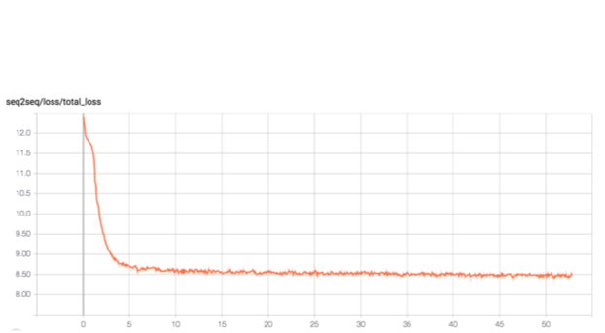
2. Training Need Very long time. Aili Mi. Need 30 days for a training.
Training on Nvidia GTX 8 The loss after 24 hours.

Slide 29
Thanks

